Slide 1
A complete guide to programming in c++
Chapter 5 – operators for fundamental types

Slide 2
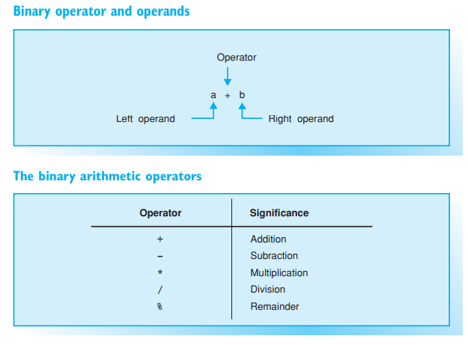
OPERATORS FOR FUNDAMENTAL TYPES
If a program is to be able to process the data input it receives, you must define the operations to be performed for that data.
The operations being executed will depend on the type of data — you could add, multiply, or compare numbers, for example. However, it would make no sense at all to multiply strings

Slide 3
Binary arithmetic operators
Arithmetic operators are used to perform calculations. You should be aware of the following:
Divisions performed with integral operands will produce integral results; for example, 7/2 computes to 3. If at least one of the operands is a floating-point number, the result will also be a floating-point number; e.g., the division 7.0/2 produces an exact result of 3.5.
Remainder division is only applicable to integral operands and returns the remainder of an integral division. For example, 7%2 computes to 1.
EXAMPLE

Slide 4
expressions
In its simplest form an expression consists of only one constant, one variable, or one function call. Expressions can be used as the operands of operators to form more complex expressions. An expression will generally tend to be a combination of operators and operands.
Each expression that is not a void type returns a value. In the case of arithmetic expressions, the operands define the type of the expression.
Normal mathematical rules (multiplication before addition) apply when evaluating an expression, i.e. the *, /, % operators have higher precedence than + and -. However, you can use parentheses to apply a different precedence order.
EXAMPLE

Slide 5
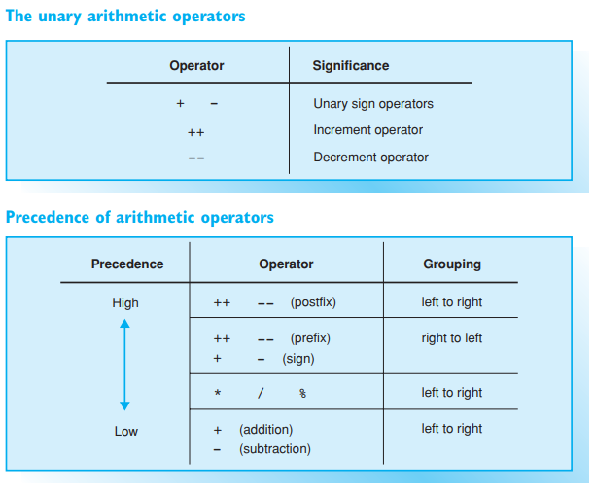
Unary arithmetic operators

Slide 6
Unary and sign operators
There are four unary arithmetic operators: the sign operators + and -, the increment operator ++, and the decrement operator --.
The sign operator – returns the value of the operand but inverts the sign.
The sign operator + performs no useful operation, simply returning the value of its operand.

Slide 7
Increment / Decrement Operators
The increment operator ++ modifies the operand by adding 1 to its value and cannot be used with constants for this reason.
Given that i is a variable, both i++ (postfix notation) and ++i (prefix notation) raise the value of i by 1. In both cases the operation i=i+1 is performed.
However, prefix ++ and postfix ++ are two different operators. The difference becomes apparent when you look at the value of the expression; ++i means that the value of i has already been incremented by 1, whereas the expression i++ retains the original value of i.
This is an important difference if ++i or i++ forms part of a more complex expression:
++i i is incremented first and the new value of i is then applied
i++ the original value of i is applied before i is incremented.
The decrement operator -- modifies the operand by reducing the value of the operand by 1. As the EXAMPLE shows, prefix or postfix notation can be used with --.

Slide 8
precedence
Operator precedence determines the order of evaluation, i.e. how operators and operands are grouped.
EXAMPLE
As you can see from the table opposite, ++ has the highest precedence and / has a higher precedence than -. The EXAMPLE is evaluated as follows: (val++) – (7.0/2.0). The result is 1.5, as val is incremented later.
If two operators have equal precedence, the expression will be evaluated as shown in column three of the table. EXAMPLE

Slide 9
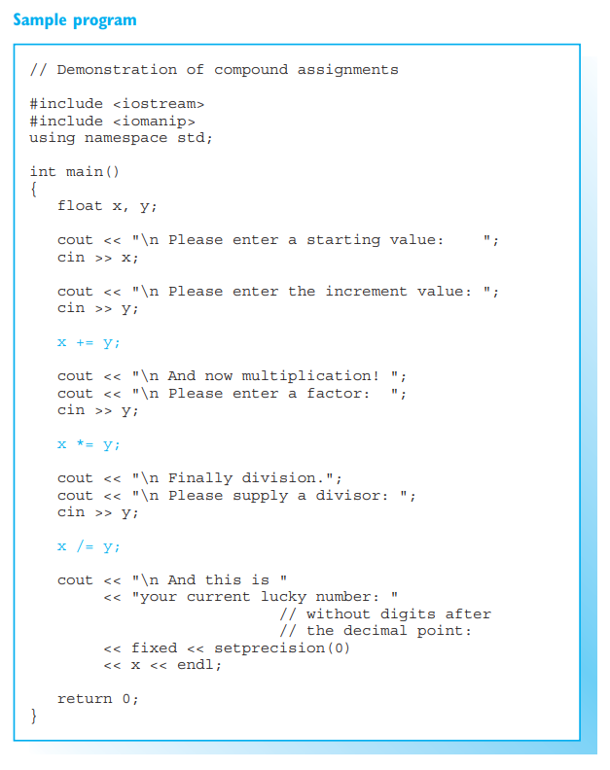
assignments

Slide 10
Simple assignments
A simple assignment uses the assignment operator = to assign the value of a variable to an expression. In expressions of this type the variable must be placed on the left and the assigned value on the right of the assignment operator.
EXAMPLE
The assignment operator has low precedence. In the case of the EXAMPLE, the right side of the expression is first evaluated and the result is assigned to the variable on the left.
Each assignment is an expression in its own right, and its value is the value assigned.
EXAMPLE
In this assignment the number 2.5 is assigned to x and then passed to the function as an argument.
Multiple assignments, which are always evaluated from right to left, are also possible.
EXAMPLE
In this case the value 9 is first assigned to j and then to i

Slide 11

Compound Assignments
In addition to simple assignment operators there are also compound assignment operators that simultaneously perform an arithmetic operation and an assignment, for example.
The second example shows that compound assignments are implicitly placed in parentheses, as is demonstrated by the fact that the precedence of the compound assignment is just as low as that of the simple assignment.
Compound assignment operators can be composed from any binary arithmetic operator (and, as we will see later, with bit operators).
The following compound operators are thus available: +=, -=, *=, /=, and %=.
You can modify a variable when evaluating a complex expression by means of an assignment or the ++, -- operators. This technique is referred to as a side effect. Avoid use of side effects if possible, as they often lead to errors and can impair the readability of your programs

Slide 12
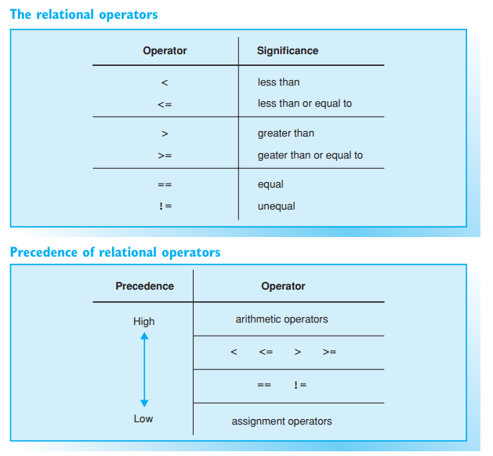
Relational operators

Slide 13
The Result of Comparisons
Each comparison in C++ is a bool type expression with a value of true or false, where true means that the comparison is correct and false means that the comparison is incorrect.
EXAMPLE
If the variables length and circuit contain the same number, the comparison is true and the value of the relational expression is true. But if the expressions contain different values, the value of the expression will be false.
When individual characters are compared, the character codes are compared. The result therefore depends on the character set you are using.

Slide 14
Precedence of Relational Operators
Relational operators have lower precedence than arithmetic operators but higher precedence than assignment operators.
EXAMPLE
In our example, max – 1 is evaluated first, then the result is compared to index, and the value of the relational expression (false or true) is assigned to the flag variable.
EXAMPLE
length + 1 is evaluated first, then the result is compared to limit, and the value of the relational expression is assigned to the result variable. Since result is an int type, a numerical value is assigned instead of false or true, i.e. 0 for false and 1 for true. It is quite common to assign a value before performing a comparison, and parentheses must be used in this case.

Slide 15
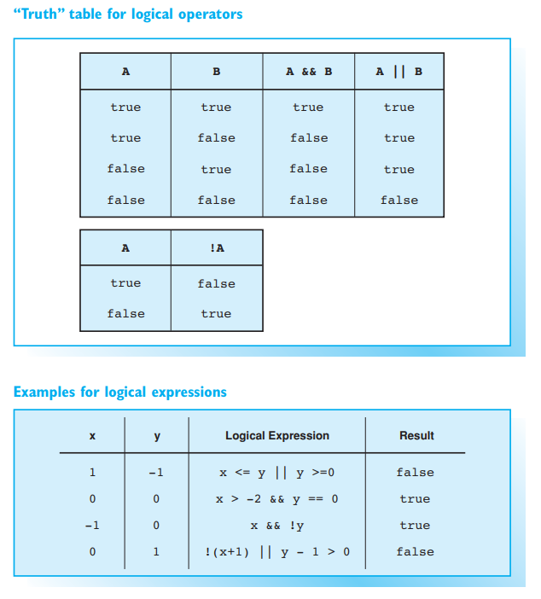
Logical operators
The logical operators comprise the boolean operators && (AND), || (OR), and ! (NOT). They can be used to create compound conditions and perform conditional execution of a program depending on multiple conditions.
A logical expression results in a value false or true, depending on whether the logical expression is correct or incorrect, just like a relational expression

Slide 16
Operands and Order of Evaluation
The operands for boolean type operators are of the bool type. However, operands of any type that can be converted to bool can also be used, including any arithmetic types. In this case the operand is interpreted as false, or converted to false, if it has a value of 0. Any other value than 0 is interpreted as true.
The OR operator || will return true only if at least one operand is true
The AND operator && will return true only if both operands are true
The NOT operator ! will return true only if its operand is false. If the variable flag contains the value false (or the value 0), !flag returns the boolean value true.

Slide 17
Precedence of Boolean Operators
The && operator has higher precedence than ||. The precedence of both these operators is higher than the precedence of an assignment operator, but lower than the precedence of all previously used operators.
The ! operator is a unary operator and thus has higher precedence

Slide 18
exercises
1) What values do the following arithmetic expressions have?
a. 3/10
b. 11%4
c. 15/2.0
d. 3 + 4 % 5
e. 3 * 7 % 4
f. 7 % 4 * 3

Slide 19
exercises
2)
a. How are operands and operators in the following expression associated?
x = –4 * i++ – 6 % 4;
Insert parentheses to form equivalent expressions.
b. What value will be assigned in part a to the variable x if the variable i has a value of –2?

Slide 20
EXERCISES
3) The int variable x contains the number 7. Calculate the value of the following logical expressions:
a. x < 10 && x >= –1
b. !x && x >= 3
c. x++ == 8 || x == 7

